Slide 1

Team: #84 Ultrasonic Radio
Amplifier and Filter
Frequency Modulator
Filter and Power Amplifier
Transmitter/Receiver
Amplifier and Filter
Frequency Demodulator
Filter and Output Voice
The ultrasonic radio's input microphone covers human voice frequencies (100 Hz to 3 kHz), translating voice into an electrical signal. This signal is amplified and filtered to enhance its quality and eliminate unwanted noise. Next, it's modulated to ultrasonic frequencies for transmission, with optional additional filtering. The modulated signal goes through a power amplifier to achieve the required gain, then travels to the receiving microphone, where it's filtered and amplified for demodulation. After demodulation, it's filtered and output through a speaker within the human hearing range.

Slide 2
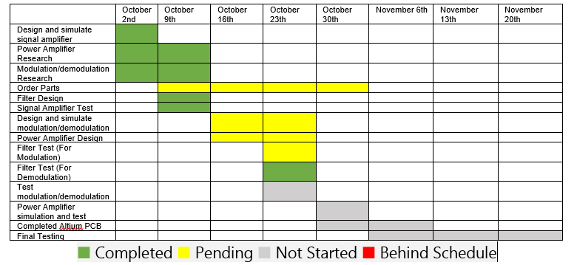
Team: #84 Ultrasonic Radio

Slide 3
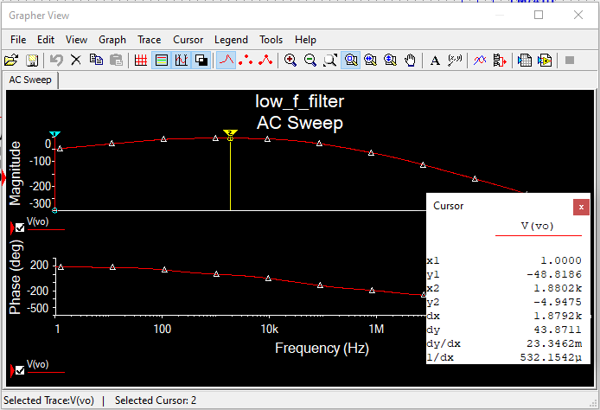
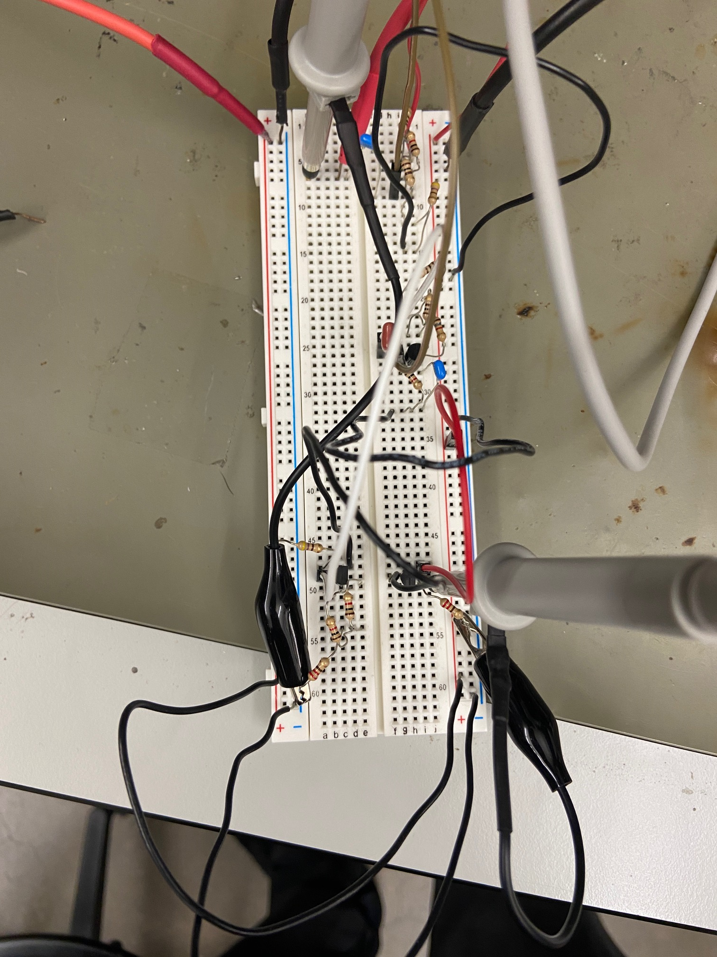
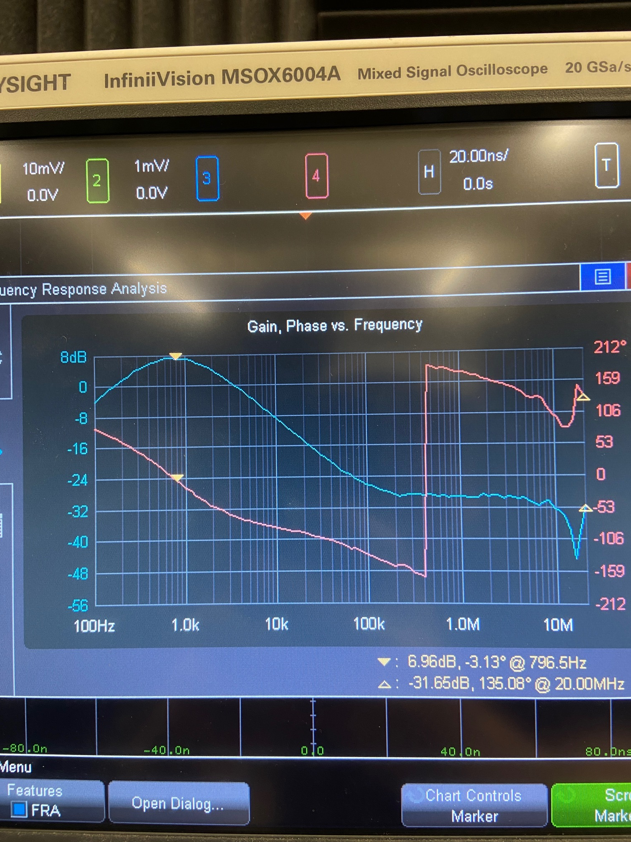
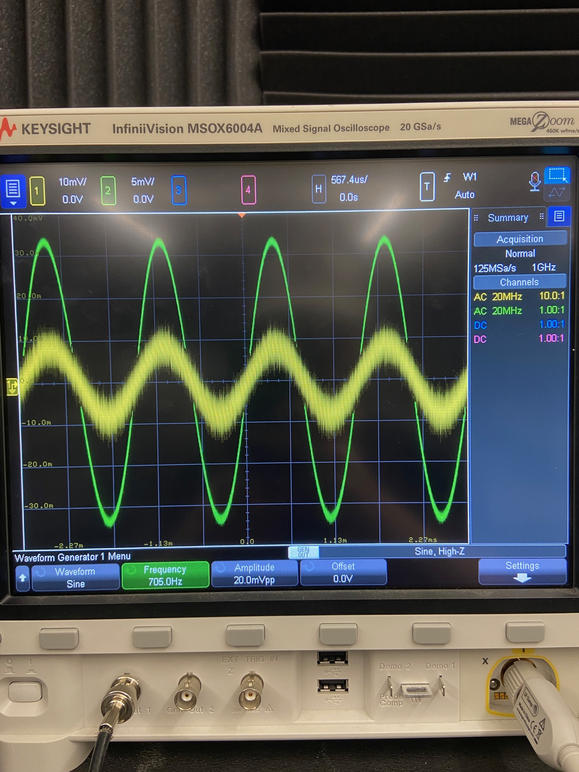
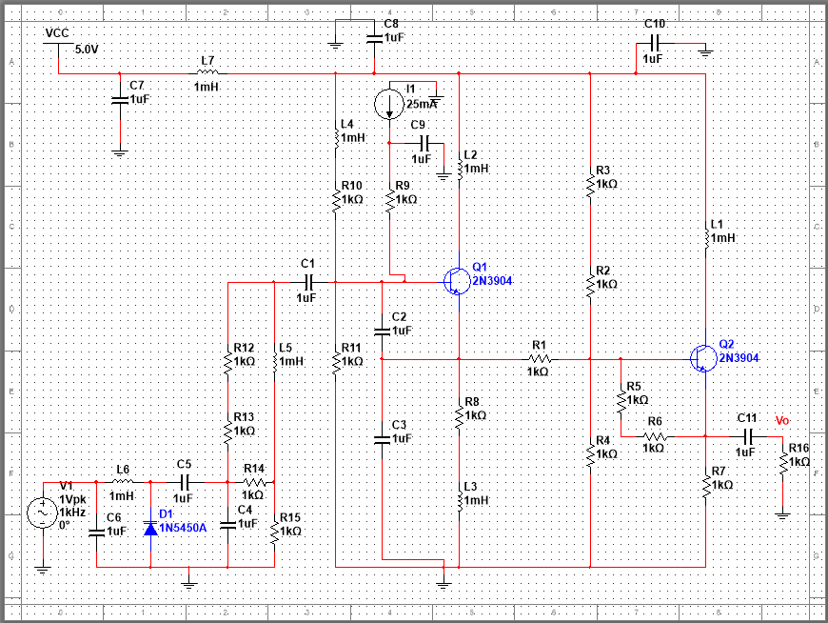
Signal Amplifier/Low Frequency Filter/Frequency Modulator Nathan Cinocca
Accomplishments since the last presentation 40 hrs | Ongoing progress/problems and plans until the next presentation
Designed, Simulated, and Tested Signal Amplifier Design and Simulated Low Frequency Filter Created Design for Frequency Modulator | Signal Amplifier gain is low Planning to do more work on Modulator and Power Amplifier Practice with Altium for PCB

Slide 4
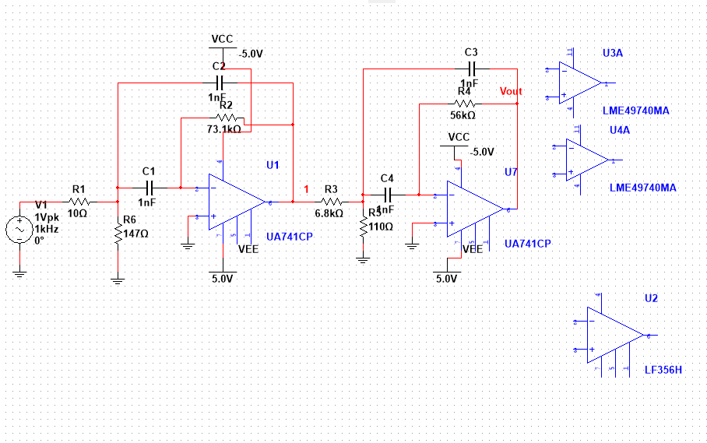
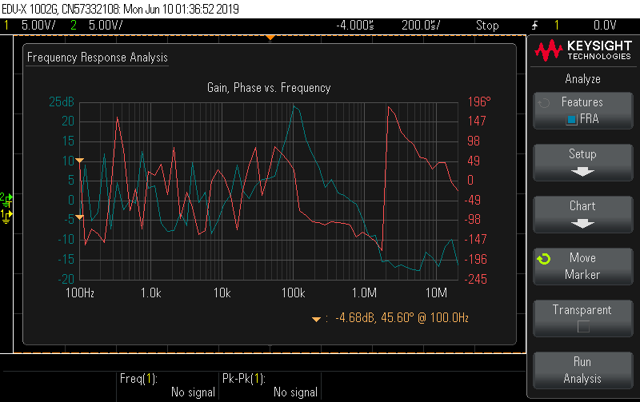
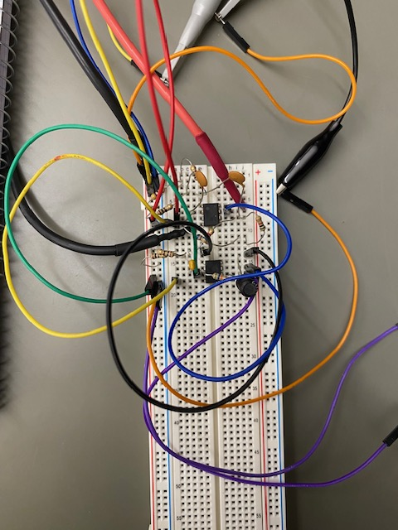
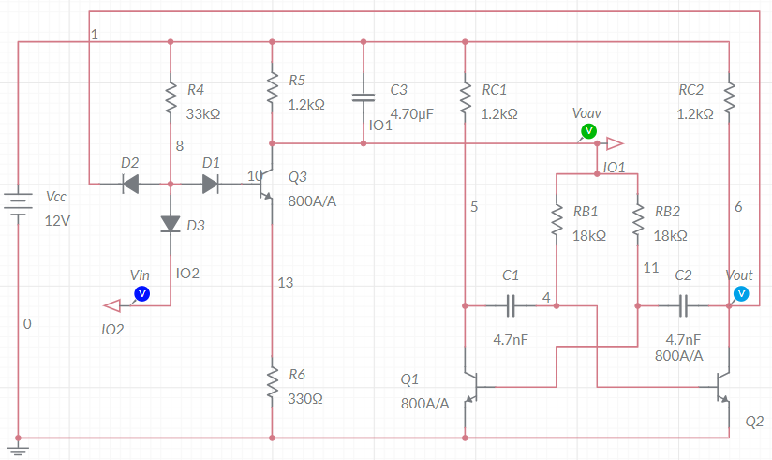
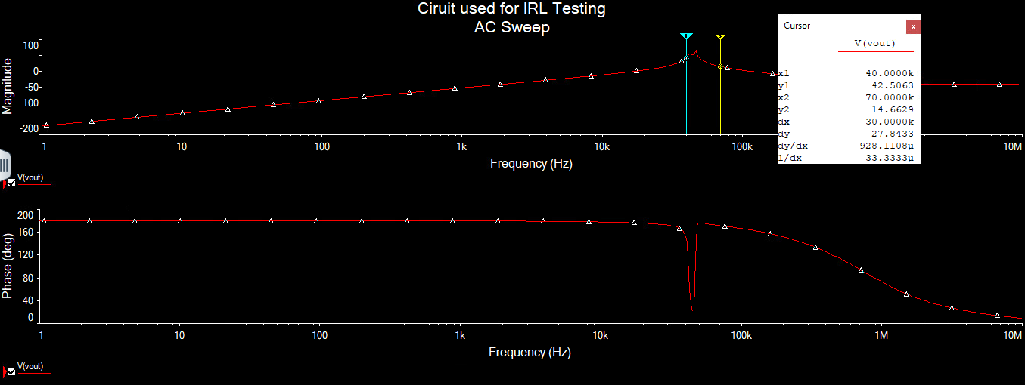
Signal Amplifier, High Frequency Filter, Demodulator Jacob Ralls
Accomplishments since the last presentation 40 hrs | Ongoing progress/problems and plans until the next presentation
Designed, Simulated, and Tested 4th Order Chebyshev Bandpass Filter FM Demodulation Design using PPL Created | Issue with noisy lower frequencies for the bandpass filter Simulations and Testing for the Demodulator Designing of Altium board with progress

